Slide 1


Artificial Intelligence
Adversarial Search

Slide 2
Multiagent environments
Each agent needs to consider the actions of other agents and how they affect its own welfare.
  The unpredictability of these other agents can introduce contingencies into the agent’s problem-solving process
Competitive environments
  the agents’ goals are in conflict, giving rise to adversarial search problems—often known as games.
Co-operative environments
  taxi-driver

Slide 3
Game Theory
In AI, the most common games are of a rather specialized kind—what game theorists call deterministic, turn-taking, two-player, zero-sum games of perfect information (such as chess).
  Deterministic, Fully observable environments in which two agents act alternately and in which the utility values at the end of the game are always equal and opposite.
  For example, if one player wins a game of chess, the other player necessarily loses. It is this opposition between the agents’ utility functions that makes the situation adversarial.
Zero-sum is a situation in game theory in which one person's gain is equivalent to another's loss, so the net change in wealth or benefit is zero.

Slide 4
Adversarial search
competitive environments, in which the agents’ goals are in conflict, giving rise to adversarial search problems—often known as games.

Slide 5
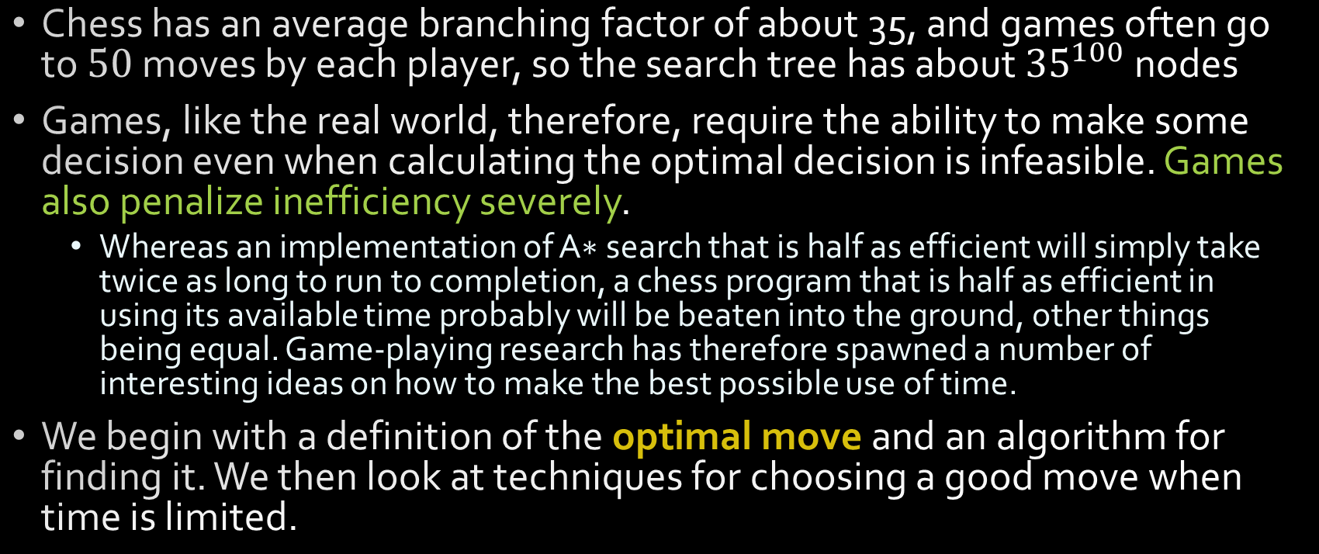
Adversarial search

Slide 6
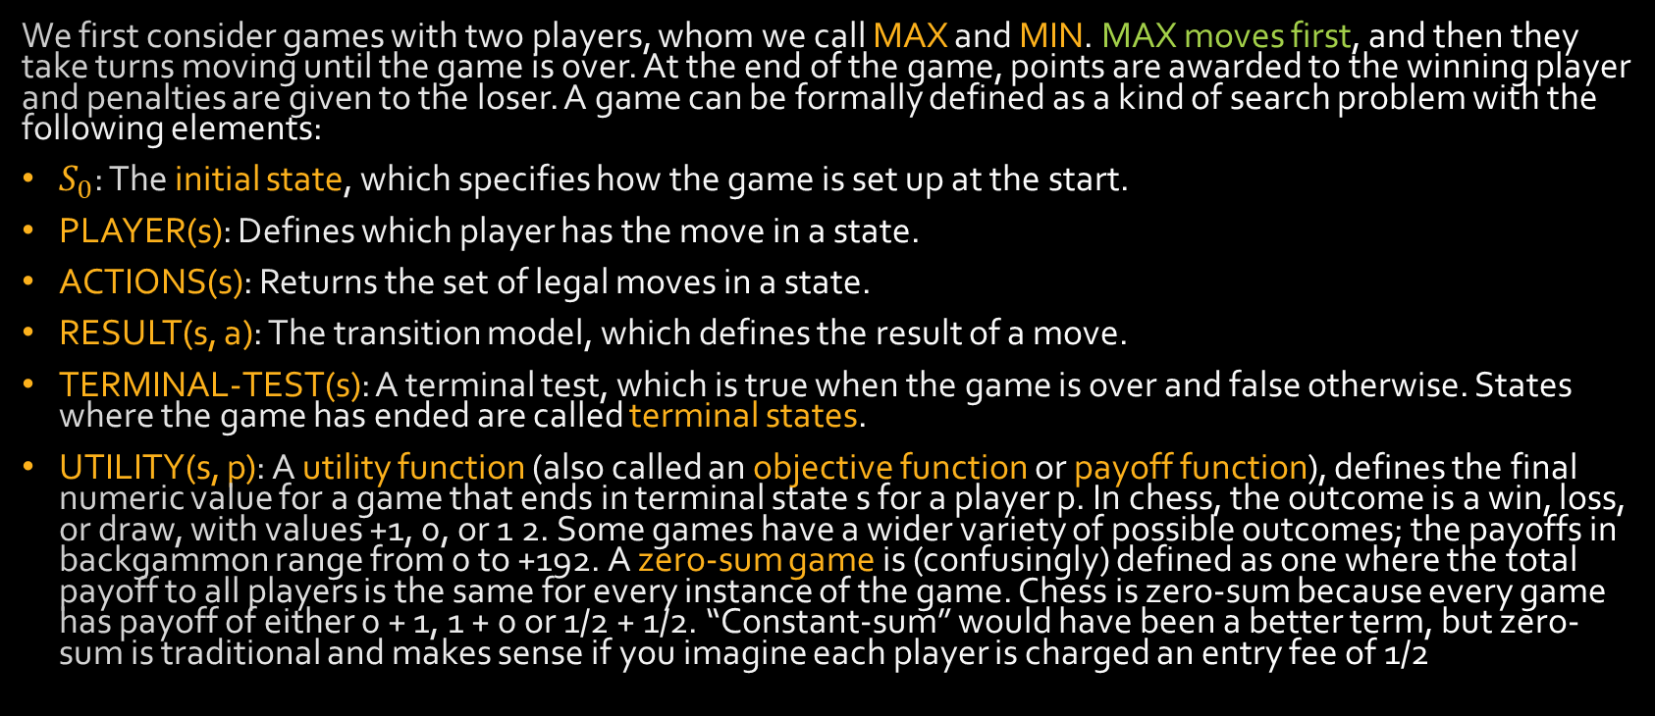
Games

Slide 7
Games
The initial state, ACTIONS function, and RESULT function define the game tree for the game—a tree where the nodes are game states and the edges are moves.

Slide 8
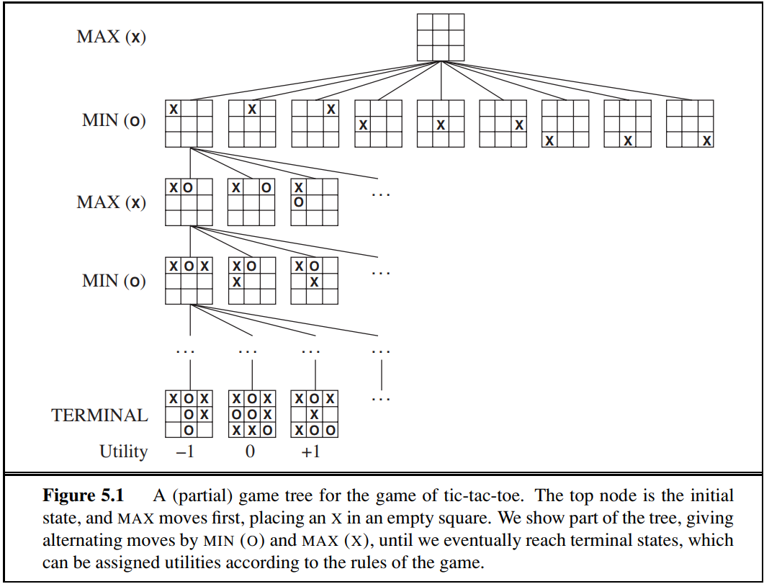
Game Tree

Slide 9
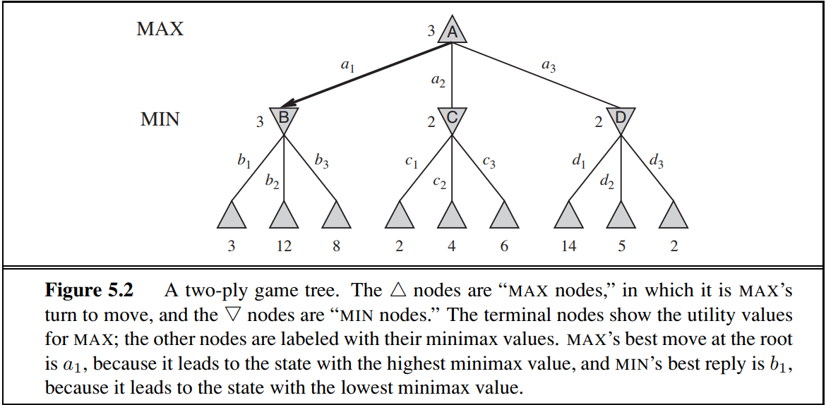
The minimax algorithm

Slide 10
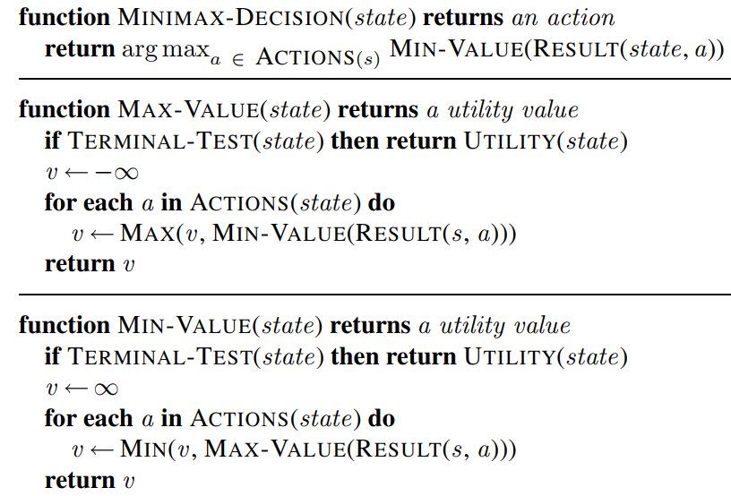
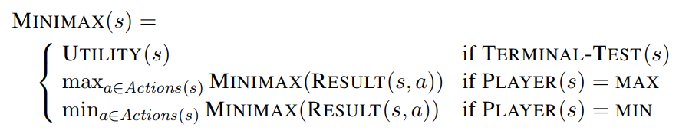
The minimax algorithm
Given a game tree, the optimal strategy can be determined from the minimax value of each node, which we write as MINIMAX(n).
  The minimax value of a node is the utility (for MAX) of being in the corresponding state, assuming that both players play optimally from there to the end of the game.
  Obviously, the minimax value of a terminal state is just its utility.
  Furthermore, given a choice, MAX prefers to move to a state of maximum value, whereas MIN prefers a state of minimum value.

Slide 11
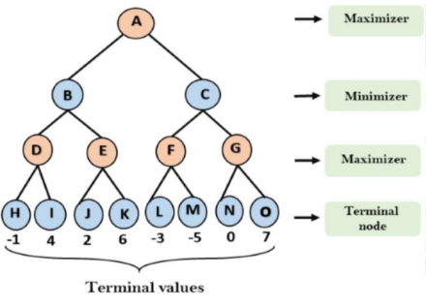
Example

Slide 12
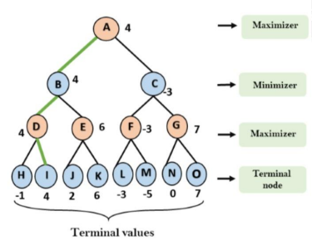
Example
The final path for Max A→B→D→I

Slide 13
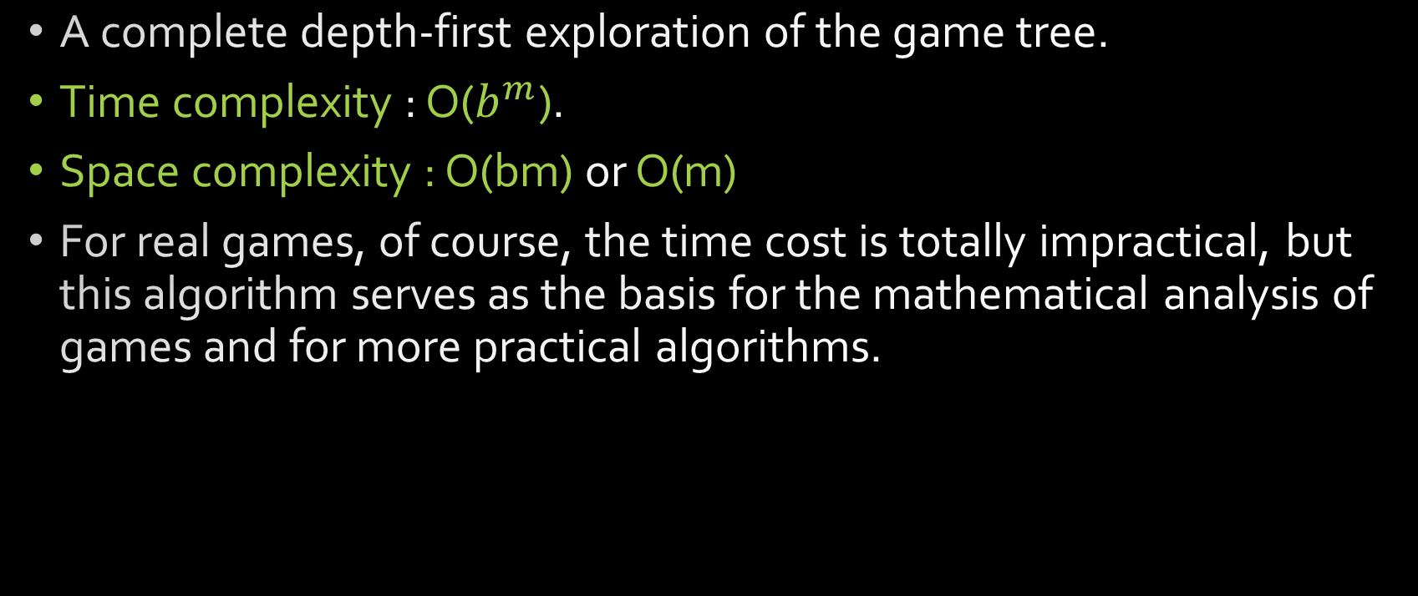
The minimax algorithm

Slide 14
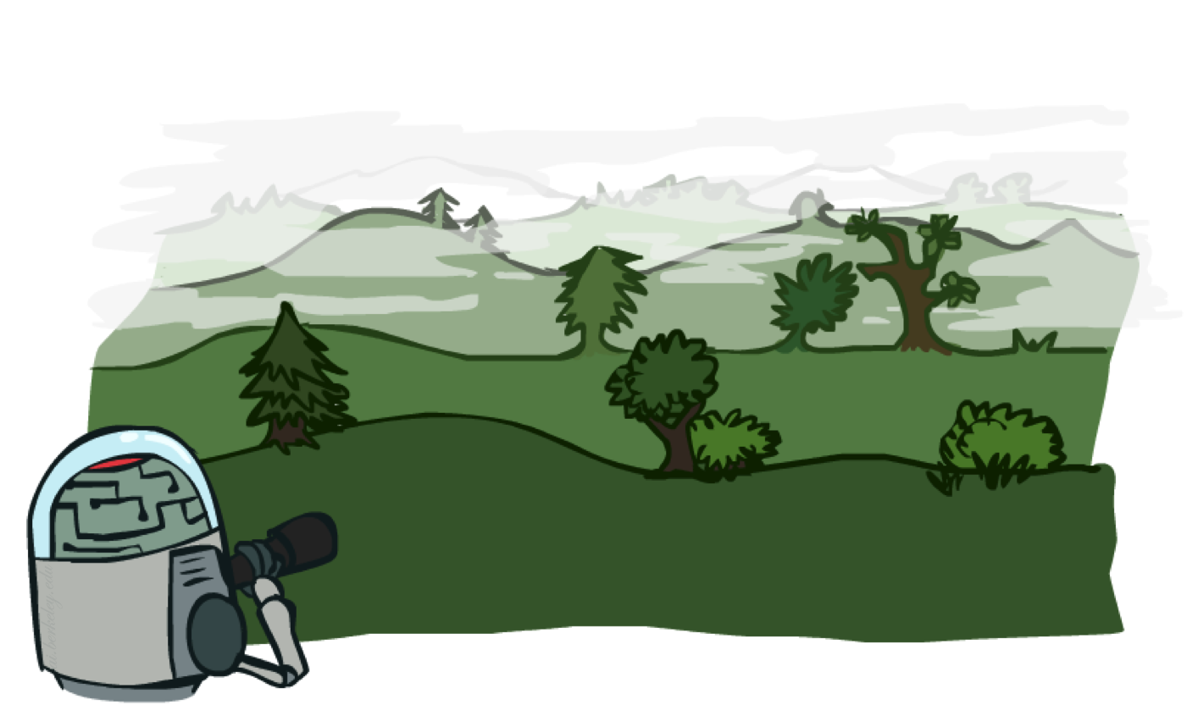
Resource Limits

Slide 15
The minimax algorithm
4
max
-2
4
min
Problem: In realistic games, cannot search to leaves!
Solution: Depth-limited search
  Instead, search only to a limited depth in the tree
  Replace terminal utilities with an evaluation function
  for non-terminal positions
Example:
  Suppose we have 100 seconds, can explore 10K nodes / sec
  So can check 1M nodes per move
  α-β reaches about depth 8 – decent chess program
-1
-2
4
9
?
?
?
?

Slide 16
The minimax algorithm
4
max
-2
4
min
Guarantee of optimal play is gone
Evaluation functions are always imperfect
The deeper in the tree the evaluation function is buried,
the less the quality of the evaluation function matters
An important example of the tradeoff
between complexity of features and
complexity of computation
But do we always need to iterate the whole tree?
-1
-2
4
9
?
?
?
?

Slide 17
Iterating with Limited Resources
Pruning allows us to ignore portions of the search tree that make no difference to the final choice
Heuristic evaluation functions allow us to approximate the true utility of a state without doing a complete search.

Slide 18
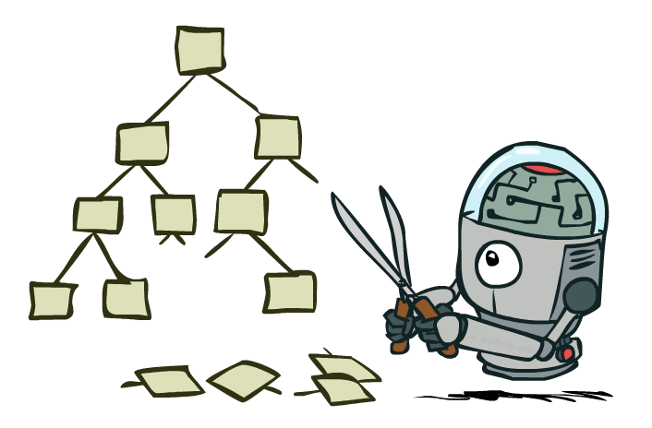
Game Tree Pruning

Slide 19
Minimax Search: Pruning
The problem with minimax search is that the number of game states it has to examine is exponential in the depth of the tree.
  We can’t eliminate the exponent,
  But it turns out we can effectively cut it in half.
  The trick is that it is possible to compute the correct minimax decision without looking at every node in the game tree.

Slide 20
Minimax Search: Pruning
Alpha–beta pruning.
  When applied to a standard minimax tree, it returns the same move as minimax would, but prunes away branches that cannot possibly influence the final decision.
  α = the value of the best (i.e., highest-value) choice we have found so far at any choice point along the path for MAX.
  β = the value of the best (i.e., lowest-value) choice we have found so far at any choice point along the path for MIN.

Slide 21
Alpha Beta pruning

Slide 22
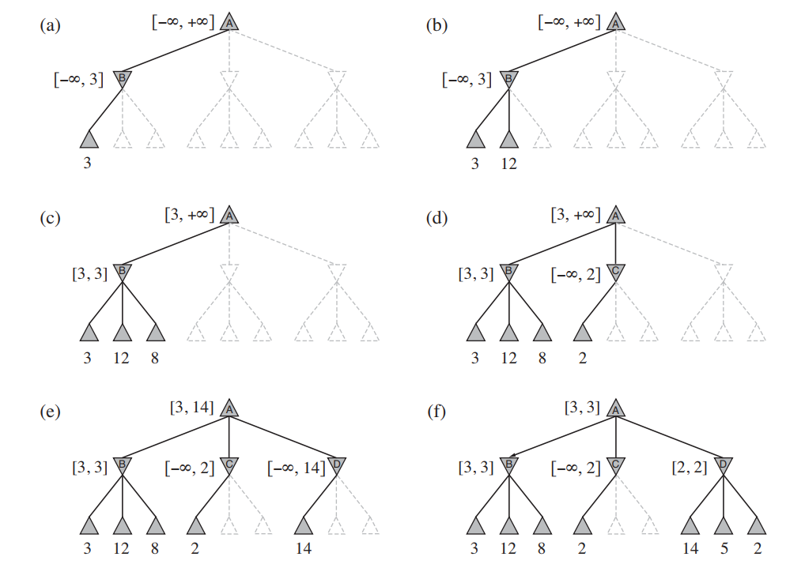

Slide 23
2
2
2

Slide 24
Example of Alpha Beta Pruning

Slide 25
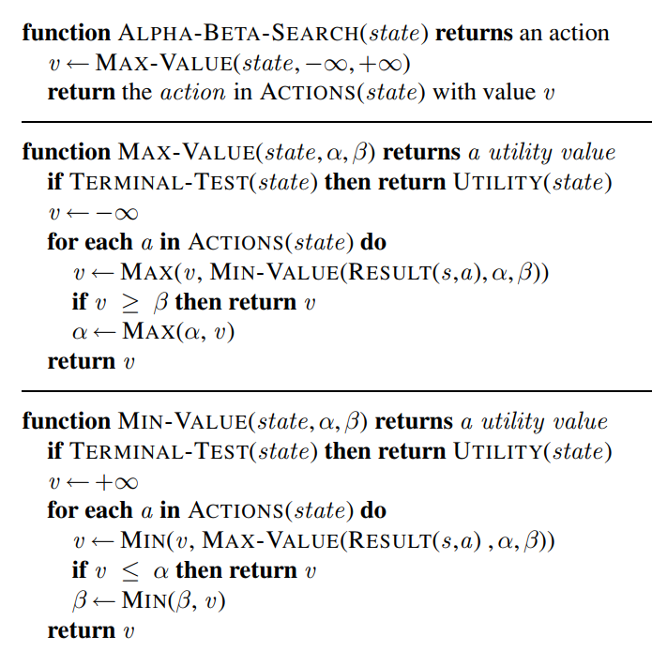
4
6
7
9
1
2
0
1

Slide 26
-inf | -inf | +inf
-inf | +inf
4
6
7
9
1
2
0
1

Slide 27
-inf | -inf | +inf
-inf | +inf
+inf | -inf | +inf
-inf | +inf
-inf | -inf | +inf
4
6
7
9
1
2
0
1

Slide 28
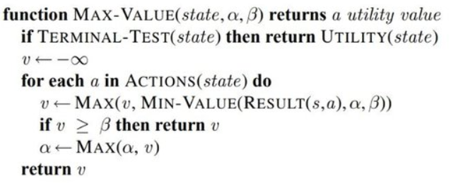
-inf | -inf | +inf
-inf | +inf
+inf | -inf | +inf
-inf | +inf
4 | 4 | +inf
4
6
7
9
1
2
0
1

Slide 29

-inf | -inf | +inf
-inf | +inf
+inf | -inf | +inf
-inf | +inf
6 | 6 | +inf
4
6
7
9
1
2
0
1

Slide 30
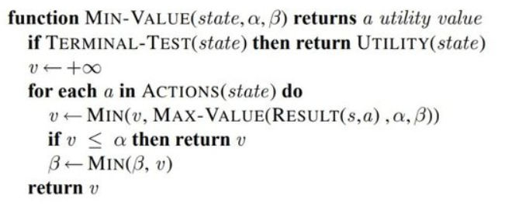
-inf | -inf | +inf
-inf | +inf
6 | -inf | 6
6 | 6 | +inf
6
4
6
7
9
1
2
0
1

Slide 31

-inf | -inf | +inf
-inf | +inf
6 | -inf | 6
-inf | 6
6 | 6 | +inf
-inf | -Inf | 6
4
6
7
9
1
2
0
1

Slide 32

-inf | -inf | +inf
-inf | +inf
6 | -inf | 6
-inf | 6
6 | 6 | +inf
7 | 7 | 6
4
6
7
9
1
2
0
1

Slide 33


-inf | -inf | +inf
-inf | +inf
6 | -inf | 6
-inf | 6
6 | 6 | +inf
7 | 7 | 6
4
6
7
9
1
2
0
1

Slide 34
-inf | -inf | +inf
-inf | +inf
6 | -inf | 6
6 | 6 | +inf
7 | 7 | 6
7
4
6
7
9
1
2
0
1

Slide 35
6 | 6 | +inf
6 | -inf | 6
6
6 | 6 | +inf
7 | 7 | 6
4
6
7
9
1
2
0
1

Slide 36
6 | 6 | +inf
6 | +inf
6 | -inf | 6
+inf | 6 | +inf
6 | 6 | +inf
7 | 7 | 6
4
6
7
9
1
2
0
1

Slide 37
6 | 6 | +inf
6 | +inf
6 | -inf | 6
+inf | 6 | +inf
6 | +inf
6 | 6 | +inf
7 | 7 | 6
-inf | 6 | +inf
4
6
7
9
1
2
0
1

Slide 38

6 | 6 | +inf
6 | +inf
6 | -inf | 6
+inf | 6 | +inf
6 | +inf
6 | 6 | +inf
7 | 7 | 6
1 | 6 | +inf
4
6
7
9
1
2
0
1

Slide 39
6 | 6 | +inf
6 | +inf
6 | -inf | 6
+inf | 6 | +inf
6 | +inf
6 | 6 | +inf
7 | 7 | 6
2 | 6 | +inf
4
6
7
9
1
2
0
1

Slide 40
6 | 6 | +inf
6 | +inf
6 | -inf | 6
2 | 6 | 2
6 | 6 | +inf
7 | 7 | 6
2 | 6 | +inf
2
4
6
7
9
1
2
0
1

Slide 41

6 | 6 | +inf
6 | +inf
6 | -inf | 6
2 | 6 | +inf
6 | 6 | +inf
7 | 7 | 6
2 | 6 | +inf
4
6
7
9
1
2
0
1

Slide 42
6 | 6 | +inf
6 | -inf | 6
2 | 6 | +inf
2
6 | 6 | +inf
7 | 7 | 6
2 | 6 | +inf
4
6
7
9
1
2
0
1

Slide 43
6 | 6 | +inf
6
6 | -inf | 6
2 | 6 | +inf
6 | 6 | +inf
7 | 7 | 6
2 | 6 | +inf
4
6
7
9
1
2
0
1

Slide 44
Practice: alpha Beta pruning
6
8
9
2
1
10
4
5
2
3
11
12

Slide 45
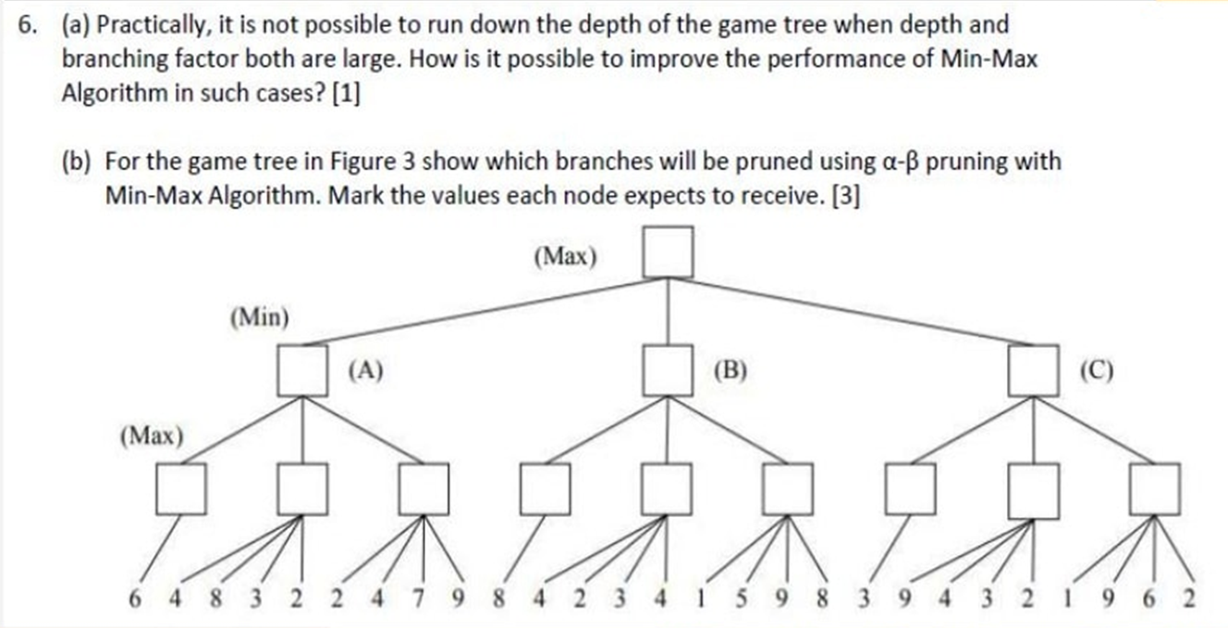
Practice: alpha Beta pruning

Slide 46
References
AIMA Chapter 4.1
Previous year questions

